Slide 1

Fork and Potato: The RPG
Group 37
Nick Milton
Stephanie Reed
Simon Chen
Adam Shu
Sean Miyaoka

Slide 2
Primary Target User: Elementary School Children
Accessibility
Using parent’s smartphone or touchpad
Will have small hands and device will be heavy to them
May hold with one hand and touch with the other
May use a smartphone in two hands
Drawn to graphics rather than excessive text content
Lots of free time

Slide 3
Primary Target User: Elementary School Children
Habits/Characteristics
Will mostly play games or watch videos
Learns quickly and highly susceptible to messages
Will nag parents if they want something
Ages 6 to 8 will take messages literally
Ages 8 to 12 will have started to develop a sense of identity

Slide 4

Orientation and Layout
Fixed portrait/vertical orientation
Common for websites
Game controls on the bottom third of the screen
No page scrolling
No page zooming
Scale the content to fit the window

Slide 5

Color Scheme
Color scheme is softer and balanced
Includes greens that can be associated with vegetables and nature

Slide 6
Controls and Navigation
Fewer and larger buttons for target audience (at least thumb size)
Every screen will have way to exit to the main menu
Pause and player messages will be overlaid Battle screen
Starting gameplay from the Welcome screen is 3 clicks

Slide 7
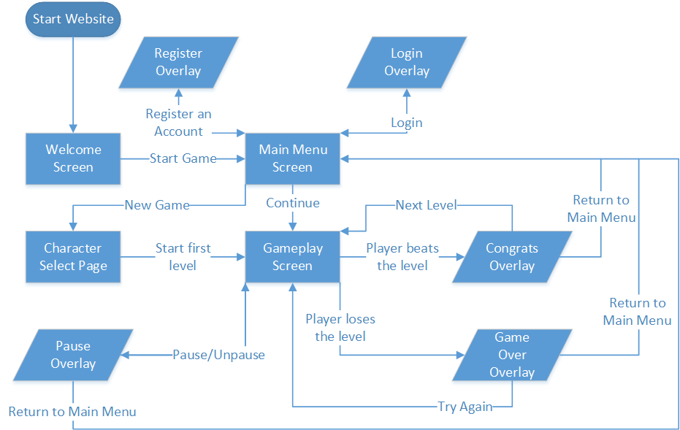
Screen Flow

Slide 8
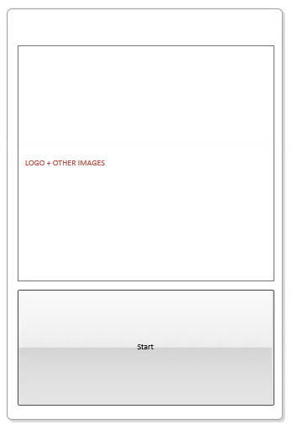
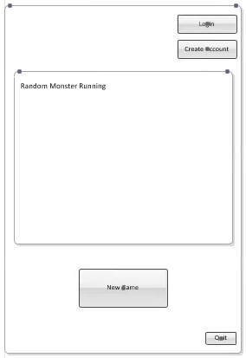
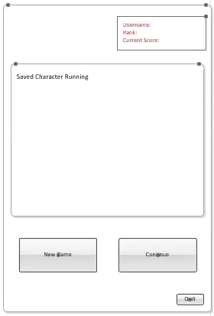
Wireframe – Start and Home screens

Slide 9
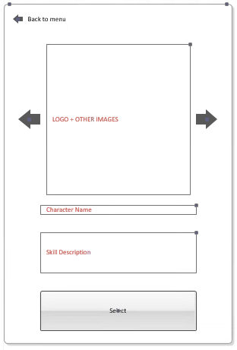
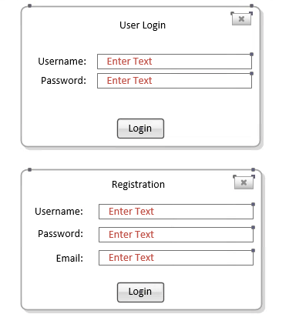
Wireframe – Login/Registration overlay, Character Select
Register

Slide 10
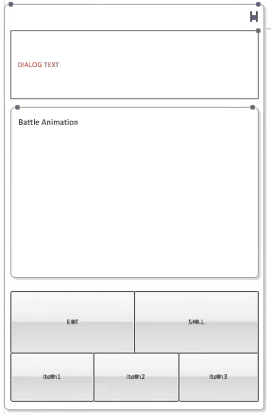
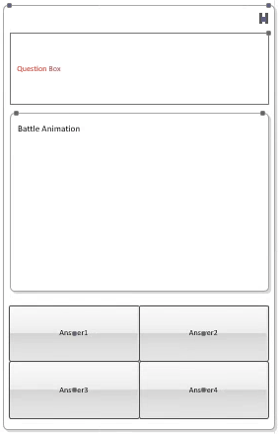
Wireframe – Battlescreens

Slide 11
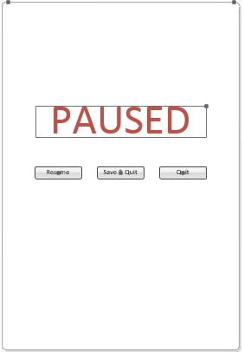
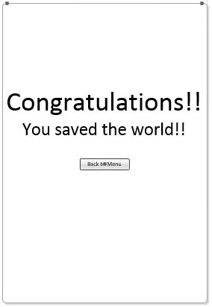
Wireframe – Paused Overlay, Game Complete screen

Slide 12



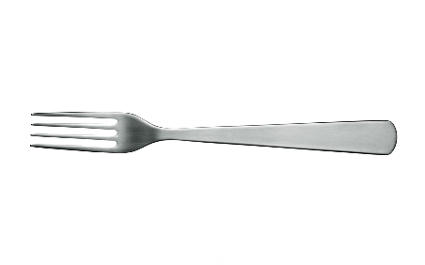
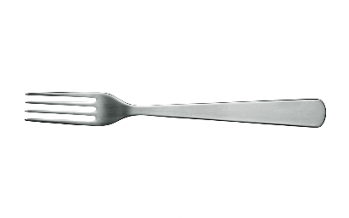
HAHAHAHA，I’m Master Potato.
No one can stop me from becoming a tree!!!
Not even YOU !
Because you don’t know the following question!
How do you PREVENT potatoes from sprouting ??
Put it in a dark place, keep it wet.
Put it in a dark place, keep it wet.
EAT
SKILL
SKILL
Put it in newspaper, keep it dry.
Put it into your mouth, just keep it.
Item1
Item1
Item1

Slide 13
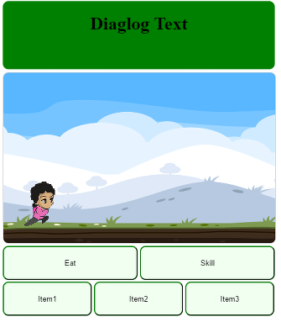
Art Concept

Slide 14
Fork and Potato: The RPG
Questions?
Group 37
Nick Milton
Stephanie Reed
Simon Chen
Adam Shu
Sean Miyaoka

